Slide 2
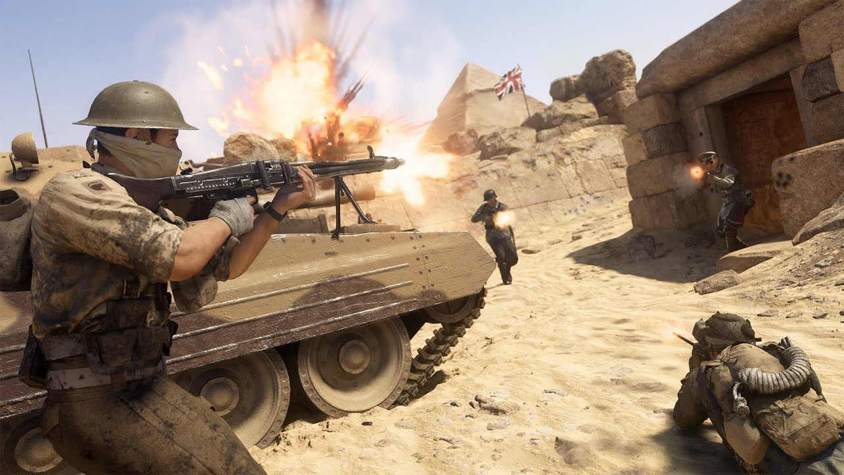
Just War Theory

Slide 3
JWT is not Pacifism
Pacifism says that war is always unjust,
and therefore always wrong.
This is an absolute statement. How does it play out?
Are pacifists concerned about themselves? Others? Both?
Does self-defense violate pacifism?
It says that aggression by a State does not need to
be resisted by war, as there are other means.
Civil Disobedience is an example. How does that play out?
NOTE: these methods may only work if the aggressor is responsive to justice

Slide 4
Goodness is stronger than evil, Love is stronger than hate,
Light is stronger than darkness, Life is stronger than death. Desmond Tutu

Slide 5
Just War Theory Combines
a moral abhorrence towards war and
a readiness to accept that war may sometimes be necessary.

Slide 6
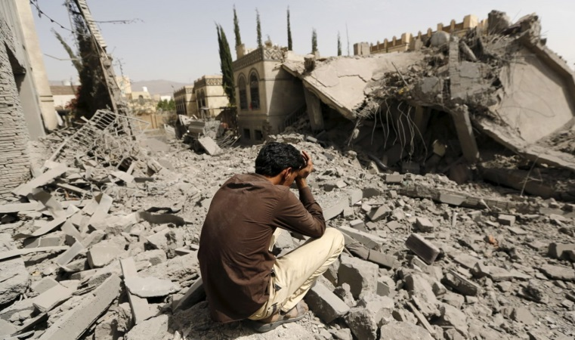
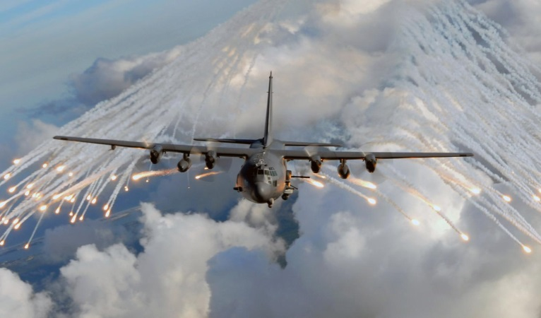
The Just War tradition addresses the morality of the use of force in two parts:
when it is right to resort to armed force-
jus ad bellum
what is acceptable when using such force-
jus in bello
In our modern day, we added—
jus post bellum
how a war terminates: its peace agreements, prosecution of war criminals, restitution.

Slide 7
Jus Ad Bellum- Right to War
Key Principles
Just cause: self-defense, defending allies, stopping aggressors, stopping genocide
Right intention
Last resort
Legitimate authority- who is this today?
Originally meant “sovereigns” (kings)
Increasingly refers to democratic governments or even the United Nations
Reasonable chance of success
Proportionality- more good than evil must be expected to result from the war

Slide 8
Just Cause in Going to War
It cannot be solely for recapturing things taken or punishing people who have done wrong.
Innocent life must be in imminent danger and intervention must be to protect life.
A contemporary view of just cause was expressed in 1993 when the US Catholic Conference said:
"Force may be used only to correct a grave, public evil, i.e. the aggression or massive violation of the basic human rights of whole populations."

Slide 9
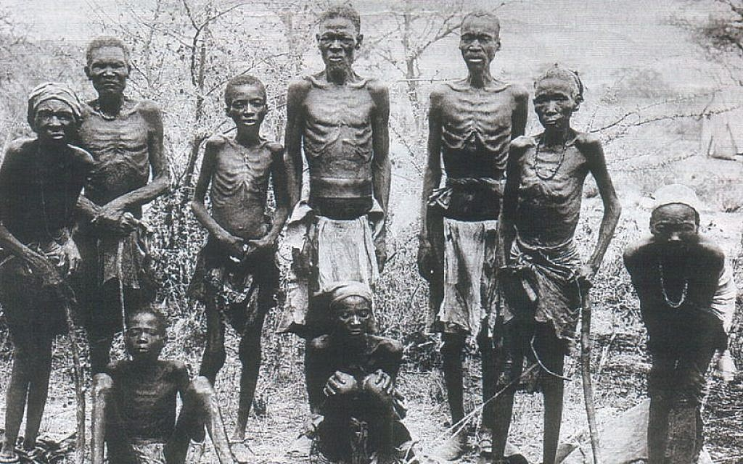

Slide 10
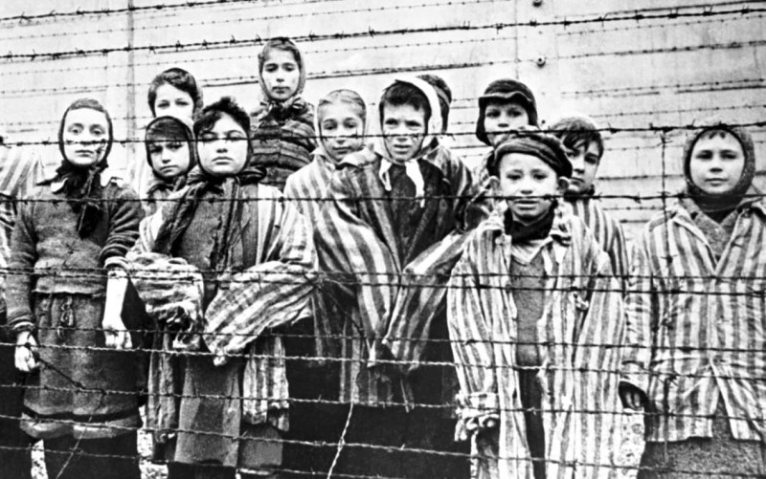

Slide 11
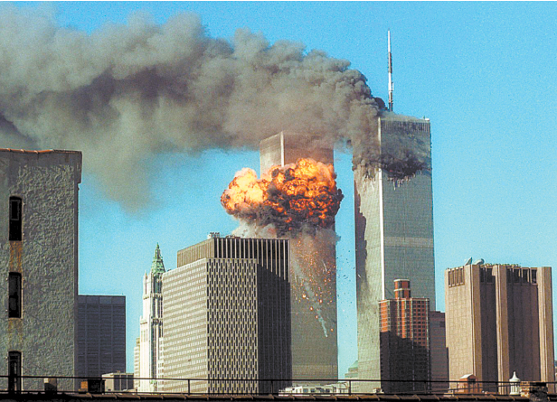

Slide 12
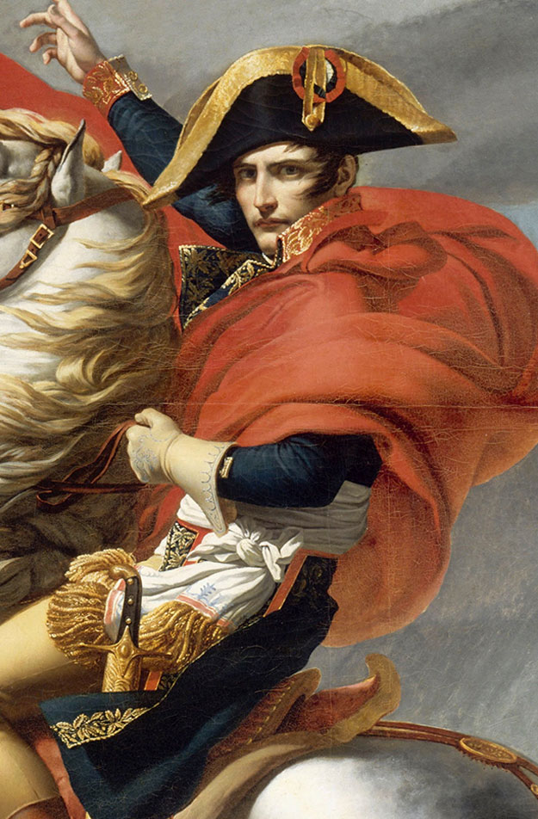
What if there are wrongs on both sides?
This requires a look at Comparative Justice.
While there may be rights and wrongs on all sides of a conflict, to override the presumption against War,
the injustice suffered by one party must significantly outweigh that suffered by the other.

Slide 13
Who is the Legitimate Authority in the case of Civil War/Rebellion?

Slide 14
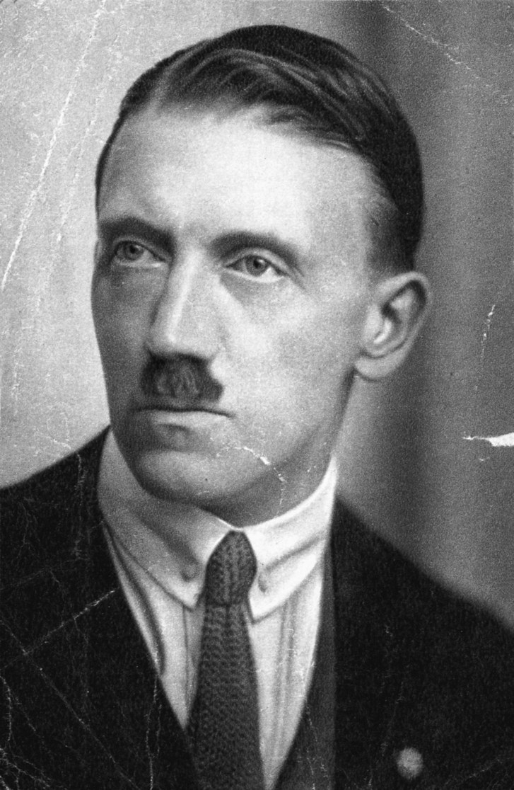
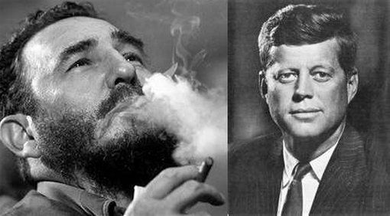
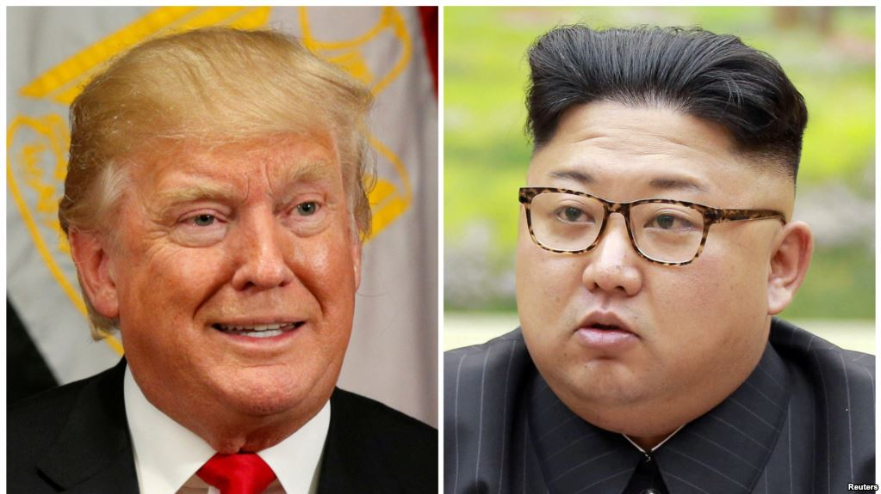
Last Resort
Force may be used only after all peaceful and viable alternatives have been seriously tried and exhausted or are clearly not practical.
It may be clear that the other side is using negotiations as a delaying tactic and will not make meaningful concessions.

Slide 15
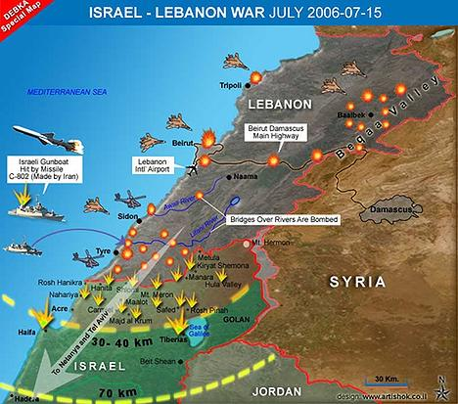
Reasonable Chance of Success
Arms may not be used in a futile cause or
in a case where disproportionate measures are required to achieve success.

Slide 16
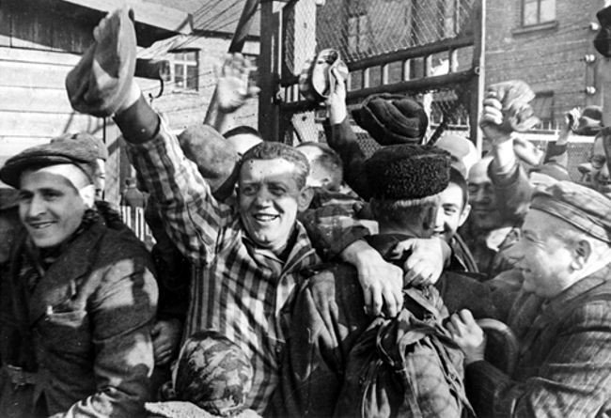
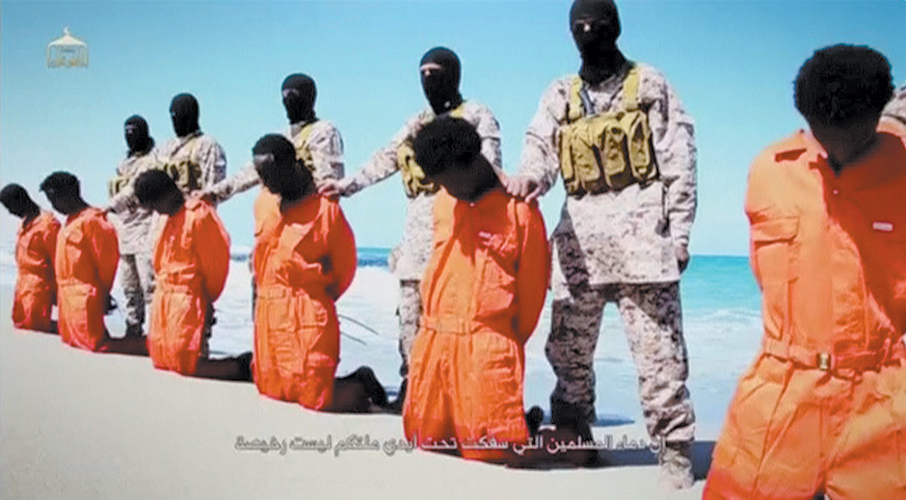
Proportionality
The anticipated benefits of waging a war must be proportionate to its expected evils or harms.

Slide 17
Jus In Bello- Right in War
Key Principles
Discrimination between civilians and combatants
What about “unlawful enemy combatants” who don’t play by the rules or identify themselves as combatants?
Proportionality of Tactics
What about guerilla warfare?
Can a conventional attack response be a nuclear strike?
Terrorism?

Slide 18
The Principle of Minimal Force
An attack or action must:
be intended to help in the military defeat of enemy
be an attack on a military objective
limit the harm caused to civilians or civilian property
be proportional and not excessive in relation to the concrete and direct military advantage anticipated
not use weapons prohibited by international law
This principle is meant to limit excessive and
unnecessary death and destruction.

Slide 19
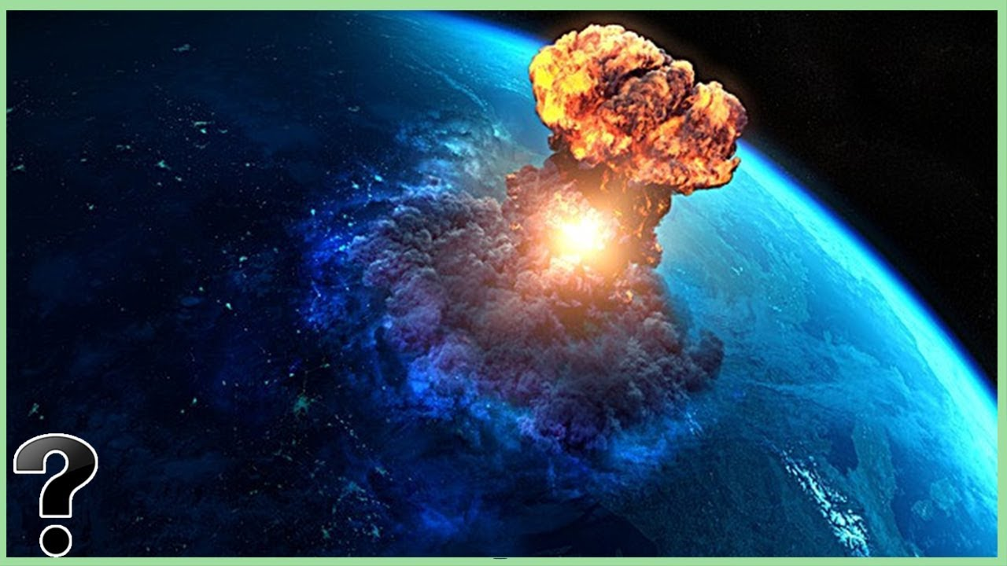
Today the horror and scale of modern warfare makes it totally unacceptable as a means of settling differences.
Pope St. John Paul II

Slide 20
Combatants v Civilians
The prohibited acts include bombing civilian residential areas that include no military target and committing acts of terrorism or reprisal against ordinary civilians.
An attack cannot be launched on a military objective in the knowledge that the incidental civilian injuries would be clearly excessive in relation to the anticipated military advantage

Slide 21
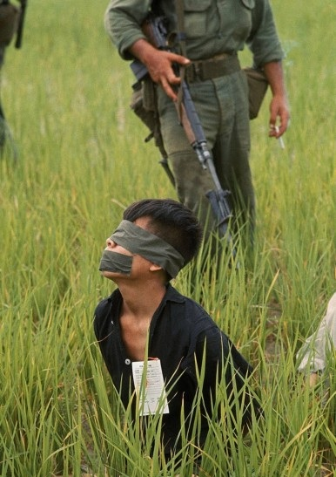
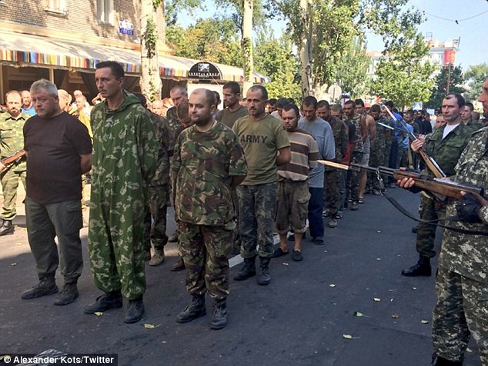
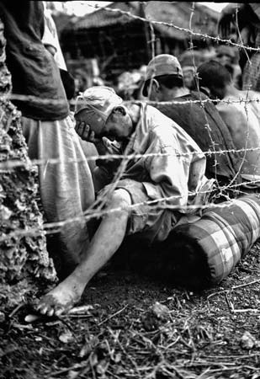
And…
Prisoners of war must be treated well- interrogation?
No weapons or means of war that are ‘evil in themselves’ are permitted.
Armed forces are not justified in breaking these rules in response to the enemy breaking these rules.

Slide 22
And, if you refuse to go?
What about a Draft?
Health
Age
Minimum? Maximum?
Gender
Education
Marital Status
Status as a Parent
Income Level
Religious Beliefs

Slide 23
Jus post Bellum- Right after War
The rights whose violation justified the war should be secured.
Just as the Declaration of War must be publicly made by the legitimate authority, so must the Declaration of Peace.
Proportionality should govern the peace settlement. It should be reasonable, not a form of revenge.
Release of Prisoners of War
Restitutions must be reasonable and attainable.
The discrimination between combatants (including political leaders) and non-combatants still applies when seeking punishment for war crimes.
Public, international trials for war crimes should be conducted.

Slide 24
Spirit of Truth,
Lead us from death to life, from falsehood to truth.
Lead us from despair to hope, From fear to trust.
Lead us from hate to love,
From war to peace.
Let peace fill our hearts,
our world,
our universe.
Let us dream together,
Pray together,
Work together,
To build one world of peace and justice for All.
AMEN.

Slide 25
https://www.youtube.com/watch?v=Fmdf9kZG-2A
2013 debate

