Slide 1
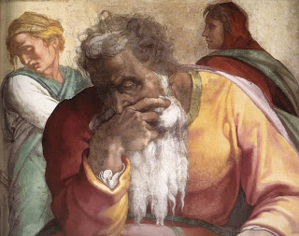
The Old Testament Basis of Catholic Social Justice Teaching

Slide 2
Part 1: The Torah

Slide 3
Genesis & Creation
Men and Women created together
Human Life calls out to God
Created enough for ALL
Man should be in harmony with Creation
Sin is disharmony (INJUSTICE)
But the key point for us is that
Man is made in God’s Image & Likeness

Slide 4
If we are made in God’s image-
each person has dignity & value.
As God is eternal, our dignity must be eternal (INALIENABLE). It is our right.
If we take God out of the conversation, on what are our rights based? The current government we live under?

Slide 5
Leviticus 16ff - Deuteronomy
Concern for the poor, widow, orphan, alien
The Sabbath moment for slaves
“fettered” Capitalism- many rules about a just way to conduct business, loans, cheating on wages
Sexual conduct- ultimate respect for marriage
Tithe- justice to YHWH and the poor

Slide 6
Part 2: The Wisdom Books

Slide 7
Proverbs 31:8-9
Job 5:15-17- A challenge as to whether God is concerned with suffering as Justice
Psalms 99:4, 106:3, 112:5, 140:12
Sirach 4:1-10 Duties to the Oppressed
34: 21-31 Unacceptable Offering to God
The wisdom writers are telling us how to live
Both HOLY and HAPPY lives.

Slide 8
Part 3: The Historical Books

Slide 9
The Historical books are a record of repeated failure to live in Justice, and, one success- a foreign woman.
1 Kings 21 Naboth’s Vineyard- don’t worry, Jezebel gets hers in 2 Kings 9:30
2 Kings 17:5-23
At one point, the court guards kill the King over his evil ways and the people of the city kill the guards and enthrone the son to continue the evil ways!
Ruth (Moabite woman) & Boaz (Jewish man)

Slide 10
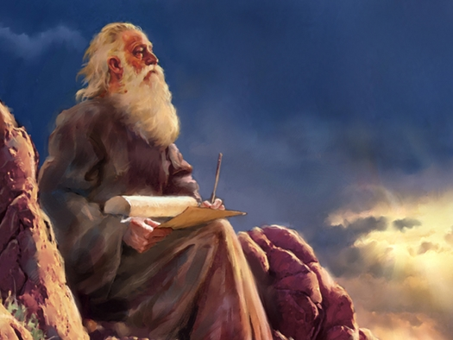
Part 4: The Prophets

Slide 11
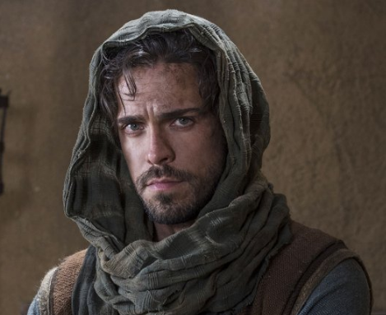
The Prophets
Isaiah 58:6-12, 61:1
Jeremiah 22:3, 13-17
Amos 2:6-7
Zechariah 7:9-10
Malachi 3:5
John the Baptist

Slide 12
… and we arrive at Jesus.
List ten ways that Jesus presents Social Justice in the Gospels.
You may chat among yourselves.
Begin!

